Slide 1
Maximizing Performance Using
Oracle9iAS Reports Services
Notes:
Schedule: Timing Topic
<xx> minutes Lecture
<xx> minutes Practice
<xx> minutes Total

Slide 2
Objectives
After completing this lesson, you should be able to
do the following:
  Describe the Oracle9iAS Reports Services architecture
  Distinguish between the JSP and Servlet run-time architectures
  Describe the various ways to run a report
  List the options for managing and monitoring Oracle9iAS Reports Services
Notes:
Lesson Aim
<Enter lesson aim here.>

Slide 3
Running Reports Using
Oracle9iAS Reports Services
  Provides the deployment platform
  Formats, prints reports on a powerful server
  Eliminates rerunning reports
  Enhances scalability and performance
Notes:
Developer/2000 Release 2
The same Release 1 functionality is still available in Developer/2000 Release 2 but, in addition, the new release provides a powerful and intelligent Reports Server that resides on a high performance server machine which is capable of processing and formatting your reports at high speed and which can return the completed output to the client machine.
Benefits of the Reports Server
Reports are formatted on a high performance NT or UNIX server.
Reports Server detects duplicate reports. Users can share output without rerunning
report.
Reports Server caches the output in a central repository on the server machine.
You can implement multiple runtime engines for one Reports Server.
You can implement multiple Reports Servers on one machine.
Class Management Note
The Reports 2.5 (Release 1) version of a report server was a single-server queue manager. Release 2 still offers this functionality. It is the Report Background Engine, and you invoke it from the R30RBE executable. (The new name is a more suitable description of its functionality.)

Slide 4
Report Request Methods
  RWCLIENT command line
  URL syntax
  Oracle9iAS Portal
  SRW.RUN_REPORT
  Event-Driven Publishing API
Notes:
Setting TOLERANCE=60 means that the Reports Server can detect a duplicate report request that you make and return the existing, cached output to the client without rerunning the report, if the existing report output is 60 minutes old or less.
Setting TOLERANCE=0 forces the report to rerun for each request. This is the default behavior.
Class Management Note
Maximum tolerance is approximately 200 days in beta-2 but increases to 2³² minutes (thousands of years) for the production release. For caching reports greater than the maximum tolerance in the beta release, we recommend you generate a static report output in advance and put the report output in the web server output directory.

Slide 5
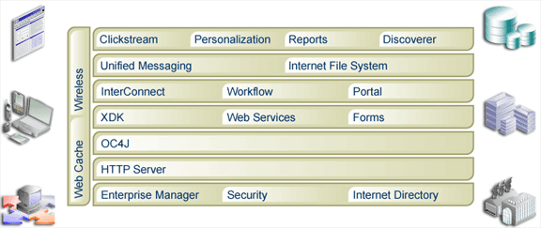
Oracle9iAS Components

Slide 6


Enabling Single Sign-On Access
Oracle Internet Directory
  Log in only once
  Access application level authentication
  Access data level authentication

Slide 7

JSP Run-time Architecture for
Running the Web Layout
HTTP
Oracle HTTP Listener
mod_OC4J
rept.jsp
JSP Engine
CORBA/IIOP
CORBA/IIOP
OID
Oracle9iAS
Reports Services
Reports
Engine
PDS

Slide 8

Servlet Run-time Architecture for
Running the Paper Layout
HTTP
Oracle HTTP Listener
mod_OC4J
Reports Servlet
Fax
Print
OID
CORBA/IIOP
mail
Oracle9iAS Reports Services
CORBA/IIOP
rept.rdf
Reports
Engine
rept.jsp
PDS

Slide 9


Peer Level Clustering
CORBA services
HTTP listener
and servlet
Reports Services cluster
Clients

Slide 10
Running a Web Report
URL syntax:
Key map file: cgicmd.dat
http://vesuvius.world.com:80/reports/rwservlet?
report=emp_dept.rdf&desformat=html&destype=cache&
server=repsrv1&dept_param=10
Notes:
SCHEDULE is a scheduling command. The default is to run the report immediately. The syntax is derived primarily from the syntax of cron on Unix. To eliminate the need for quoting the scheduling command, use underscores (_) instead of spaces.
The full syntax of the SCHEDULE command is:
[FREQ from] TIME
where:
TIME = CLOCK [DATE] [INCR]
CLOCK = <hh|mm>
DATE = <calendar date>
INCR = {+LEN} | {next SUFFIX}
LEN = {n} * SUFFIX
SUFFIX = <time, date, FREQ>
Example
SCHEDULE=hourly_from_09:00am_May_01,_1999

Slide 11
Parameters for RWCLIENT
  SERVER = <server_name>
  MODULE|REPORT = <runfile>
  DESTYPE = FILE, PRINTER, MAIL, CACHE, LOCALFILE, SYSOUT,ORACLEPORTAL
  DESNAME = <desname>
  DESFORMAT = PDF, HTML, HTMLCSS, RTF, DELIMITED, XML
RWCLIENT SERVER=server1 MODULE=my_rep.rdf DESTYPE=cache DESFORMAT=html
Notes:
SERVER = <tnsname>, new parameter, similar to R25RUN. We discuss the Reports
Server name and parameters later in this lesson.
R30CLI is invoked by a CGI script. There is a CGI version available for Web servers (R30CGI).
R30CLI sends a request to the Reports Server.
You cannot set DESTYPE to Screen or Preview when using R30CLI.
HTMLCSS uses cascading style sheets, available in Netscape 4.0. (Netscape 3.0 does not
support HTMLCSS.)
Class Management Note
DESTYPE = LOCALFILE sends output back to the PC, you must also specify DESNAME.
An online document provides help in setting up the Reports Server, including the entry in TNSNAMES.ORA. See <oracle_home>\tools\doc20\r30srvus.htm.

Slide 12
The Schedule Parameter
SCHEDULE = [FREQ from] TIME [retry n after LEN]
RWCLIENT...
SCHEDULE=monthly_last_weekday_from_17:00_Jan_22,_2002_
retry_3_after_1_hour
FREQ
CLOCK
DATE
TIME
Notes:
SCHEDULE is a scheduling command. The default is to run the report immediately. The syntax is derived primarily from the syntax of cron on Unix. To eliminate the need for quoting the scheduling command, use underscores (_) instead of spaces.
The full syntax of the SCHEDULE command is:
[FREQ from] TIME
where:
TIME = CLOCK [DATE] [INCR]
CLOCK = <hh|mm>
DATE = <calendar date>
INCR = {+LEN} | {next SUFFIX}
LEN = {n} * SUFFIX
SUFFIX = <time, date, FREQ>
Example
SCHEDULE=hourly_from_09:00am_May_01,_1999

Slide 13
Reports Caching
Cached reports on server:
  Tolerance = n (minutes)
  Tolerance = 0 (default/current behavior)
  Maximum tolerance is 2³² minutes (approximately 10,000 years)
  Cached output controlled by a CACHEDIR server parameter
Notes:
Setting TOLERANCE=60 means that the Reports Server can detect a duplicate report request that you make and return the existing, cached output to the client without rerunning the report, if the existing report output is 60 minutes old or less.
Setting TOLERANCE=0 forces the report to rerun for each request. This is the default behavior.
Class Management Note
Maximum tolerance is approximately 200 days in beta-2 but increases to 2³² minutes (thousands of years) for the production release. For caching reports greater than the maximum tolerance in the beta release, we recommend you generate a static report output in advance and put the report output in the web server output directory.

Slide 14

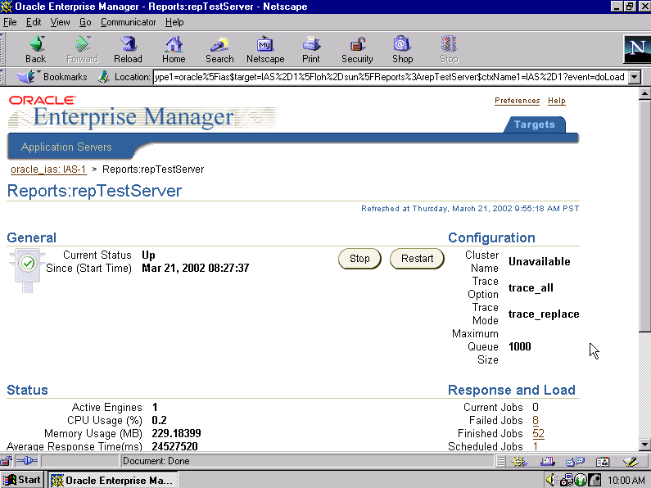
Using Oracle Enterprise Manager

Slide 15
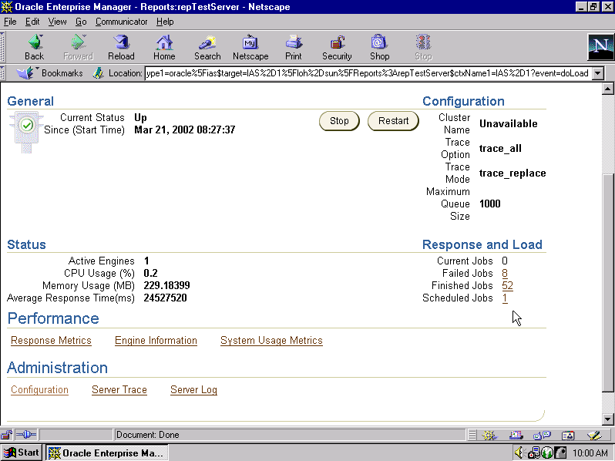
Using Oracle Enterprise Manager

Slide 16
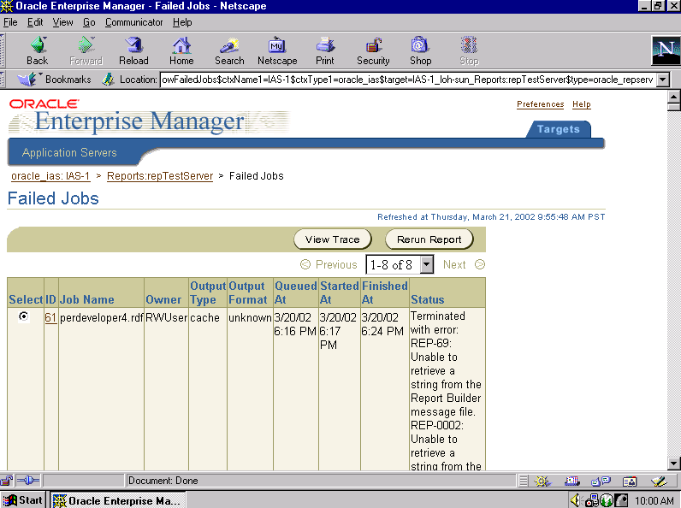
Using Oracle Enterprise Manager

Slide 17
Oracle Enterprise Manager
  Start, stop, and restart a Reports server
  View and manage:
    Current Jobs queue
    Scheduled Jobs queue
    Finished Jobs queue
  Monitor server performance
  Edit server configuration

Slide 18
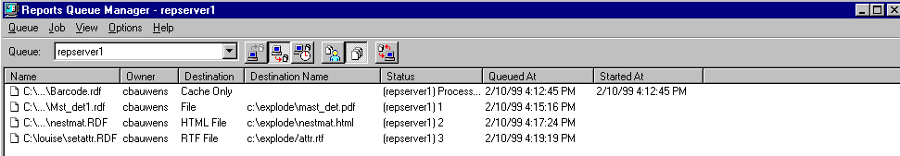
What Is the Queue Manager?
  Real-time Reports Server status:
  View report status and scheduled jobs
  Refresh to see the up-to-date status
  Reprioritize or cancel jobs
  Administrator password encrypted in .ora file
Notes:
The Queue Manager is a facility that enables users and administrators to view the current status of each report. You can see the time each report started and finished, and whether it terminated successfully or with an error.
You can also view jobs that are scheduled to run at a future date or time. Users can reprioritize or cancel their own scheduled jobs. Administrators can reprioritize or cancel anyone’s scheduled jobs.
Administrator Privilege
In the server .ora file, the first line gives an encrypted password, KEY=.
You can set this password the first time you bring up the Reports Server. At the login prompt, choose any username and password to assign as Administrator.

Slide 19
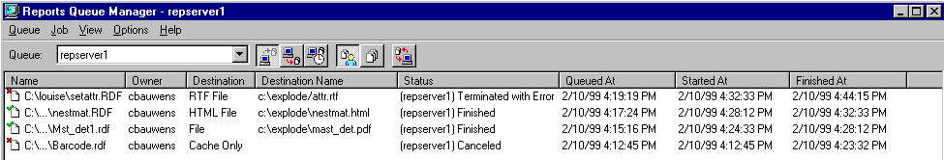
Queue Manager
Past jobs
Current jobs
Scheduled jobs
Notes:
The Queue Manager status bar allows you to switch between different views of the jobs.
Icon Name Description
Past Jobs Displays jobs that have already run for a given Reports Server.
Current Jobs Displays jobs that are currently running.
Scheduled Jobs Displays scheduled jobs, in order to reprioritize or cancel a job.
Demo
1. Invoke Reports Queue Manager.
2. Click on queue and note that <localrepserver> is the default.
3. Click Past Jobs icon.
4. Click Current Jobs icon.
5. Invoke a job.

Slide 20
Queue Manager
All my jobs
All jobs
Refresh
Notes:
The Queue Manager status bar allows you to switch between different views of the jobs.
Icon Name Description
Past Jobs Displays jobs that have already run for a given Reports Server.
Current Jobs Displays jobs that are currently running.
Scheduled Jobs Displays scheduled jobs, in order to reprioritize or cancel a job.
Demo
1. Invoke Reports Queue Manager.
2. Click on queue and note that <localrepserver> is the default.
3. Click Past Jobs icon.
4. Click Current Jobs icon.
5. Invoke a job.

Slide 21
Using the Queue Manager
RSVR1
Queue Manager
RSVR2
  Connect to any number of servers
  Administrator can shut down server
  Reports Services restores scheduled jobs after shutdown
Notes:
You can connect to any Reports Server, by changing the server name in the Queue Manager status bar.
Shutting Down the Reports Server
You can shut down the Reports Server from the Queue Manager if you have Administrator privileges.

Slide 22
Summary
In this lesson, you should have learned how to:
  Describe the JSP and servlet run-time architectures
  List several ways to run a report
  Describe the features of Oracle Enterprise Manager and Queue Manager for monitoring Reports Services
Notes:
The new Reports Server provides increased efficiency and scalability for large reports.
By caching report output, you can ensure that users do not rerun reports unnecessarily.

Slide 23
Practice 21 Overview
  Constructing a URL to run a report on the Web
  Creating an entry in the key map file
Notes:
The new Reports Server provides increased efficiency and scalability for large reports.
By caching report output, you can ensure that users do not rerun reports unnecessarily.

